Slide 1
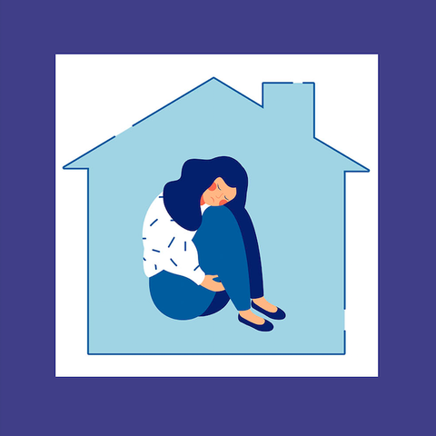
Ways to Ease Anxiety about coming out of Lockdown
You’re not on your own if you feel overwhelmed

Slide 2
Are you feeling anxious about life after lockdown? For many of us, the past year has been spent in the comfort of our homes, away from common anxiety triggers, and at a much slower pace than before. But, with the government's new roadmap plan offering a sense of normality for the future, some people may be feeling anxious about whether they will be able to readjust.
Just as we were getting comfortable with this new 'normal', the next adjustment phase could also take some getting used to — and it's OK to take your time.

Slide 3
1. TALK TO LOVED ONES or friends AROUND YOU
One of the best things you can do for your own mental health is to have open conversations with loved ones or people close to you. If you're worried you might find the transition back to 'normality' difficult, talk to others you trust.

Slide 4
2. PLAN TO DO THE THINGS YOU enjoy AGAIN
We have been living in a time like no other, so, naturally, it may take time to get back into the swing of things once lockdown is over.
A simple way to help relieve heightened levels of anxiety is to plan ahead; make a list of the simple pleasures you want to do again, friends you want to visit, places you want to travel to, or the restaurants you want to dine at.

Slide 5
3. BEGIN TO REESTABLISH YOUR OLD ROUTINE
Whether you've been working from home or have been spending more time with your household, our daily lives are looking somewhat different to what they once did. A great way to help ease you into normality again is to reestablish your old routine, such as heading to bed earlier, for example.

Slide 6
4. REVIEW YOUR PRIORITIES IN LIFE
When it comes to our personal lives, many of us are finding the current pace of life easier to deal with, as we're less pressured to attend social gatherings, for example. It's worth reflecting on whether we want things to return to how they were before, or if there's an opportunity to review our priorities and really think about what makes us happy.

Slide 7
5. BE CAREFUL WHERE YOU READ YOUR NEWS
While it's important to stay informed with the news around us, be careful where you get your information from.
If you're feeling nervous, switch off from reading or watching the news for a while and instead catch up once a day. Make sure you do things that boost your mood such as baking, drawing, reading, writing, going on a countryside walk or chatting to a friend on the phone.

Slide 8
6. REMEMBER THAT THINGS WILL TAKE A WHILE TO ADJUST
As lockdown restrictions gradually begin to lift, remember that it will take a while for life to get back to 'normal' — and it's OK if you take longer to adjust than others.
There will be many people who don't feel their concerns have been adequately addressed for whom a much slower, more gradual reintegration would be more appropriate.

Slide 9
7. LOOK AFTER YOUR HEALTH
It may seem like something small, but taking steps to look after your physical health, such as staying hydrated or trying to keep active at home or outdoors, can also help our mental health.
It may also help to express your feelings creatively by painting, writing, drawing or any other way that feels helpful to you.
Remember you are not on your own.

Slide 10
Useful Contact Numbers

Slide 11
Thank you for listening
Any Questions?

