Slide 1
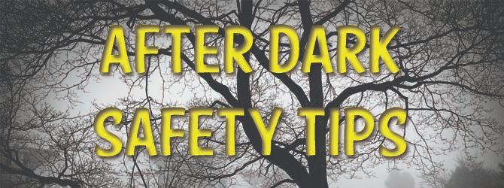
Safety After Dark
By Headway Central Lancashire

Slide 2
Aim
Discuss the statistics surrounding peoples feelings about being out after dark
Headway Central Lancashire is campaigning to reduce instances of head and brain injury by promoting personal safety during the winter period.
Offer strategies that you could use when feeling vulnerable after dark

Slide 3
Office For National Statistics
People felt less safe when walking alone after dark than during the day in a quiet street close to home; a busy public space; and a park or open space.
One in two women and one in seven men felt unsafe walking alone after dark in a quiet street near their home.
One in two women and one in five men felt unsafe walking alone after dark in a busy public place.
Four out of five women and two out of five men felt unsafe walking alone after dark in a park or other open space.
Disabled people felt less safe walking alone in all settings than non-disabled people.
Adults who experienced at least one form of harassment in the previous 12 months were more likely to feel unsafe when walking alone compared with those who had not.

Slide 4
Out in the Dark- strategies
Stay in groups where possible
Try to walk with other people that you know; safety in numbers is key when it comes to walking in the dark.
Know your route
Be sure to know where you’re going.
Plan your route ahead by using google maps or other route planning apps.
Stick to well-lit areas, use main roads and pedestrian areas.
Avoid short cuts, alleyways, parks and wasteland.
Walk along the pavement facing oncoming traffic but keep back from the curb and keep clear of recesses such as doorways.

Slide 5
Safety after Dark
Plan ahead
.
plan ahead, arrange with someone close to you to pick you up or book a taxi in advance. If you’re planning on getting a taxi, make sure you keep money aside to pay the fare and be sure to use a licensed taxi firm; never get in an unmarked taxi. If you use public transport, always check the times of the last train or bus and have a copy of the timetable, or you can download an app.
IF A BUS IS EMPTY OR IT IS AFTER DARK, STAY ON THE LOWER DECK AND SIT NEAR THE DRIVER OR CONDUCTOR. ON TRAINS, TRY TO SIT WITH OTHER PEOPLE AND AVOID EMPTY CARRIAGES; DON’T BE AFRAID TO MOVE TO ANOTHER SEAT OR CARRIAGE

Slide 6
Safety After Dark
Stay in Control
Make sure you let friends or family know where you’re going and what time they can expect you back. Keep people updated on your journey if you have to walk, or if you’re getting in a taxi, let someone know when you’re setting off, and then get back in touch with them when you’ve arrived at your destination. That way, they should know if something is wrong if you fail to contact them as expected. If you’re out with friends make sure you know how your friends are getting home too and look out for one another. And remember, when going out for the night to have a fully charged phone so you can make contact in an emergency.

Slide 7
Safety After Dark
Be alert and aware of your surroundings
If you do have to walk alone in the dark, it is important to stay alert and aware of your surroundings, with no distractions. Avoid things such as listening to music or talking on the phone for too long. Walk briskly and with confidence. It is also important to keep any valuables such as phones, headphones, money, keys etc. hidden, as they will draw attention to you, also do not carry important documents like credit cards if you do not need them. If you're carrying a bag, try to have it across your chest and keep your hand over the fastening.
If you think you are being followed, check by crossing the street. If you are worried go to the nearest place where there are other people and call the police. Do not use a phone box as you can get boxed in. If you have concerns about a group of people or a particular situation, keep away.
Be vigilant when using cash machines – protect your PIN, avoid the need to use a cashpoint late at night and if you have been drinking. If you do need to withdraw cash late at night use a machine in a well-lit area and stay with friends.

Slide 8
Safety After Dark
Contact the police if you need help
If you have experienced crime, always contact the police rather than posting on social media pages. Call 999 if a crime has just happened, you or someone else is currently in danger or the perpetrators are near by.

