Slide 1
Mental Health and Wellbeing
Headway group 28th July 2021
Katharine Lonsdale, N-Compass.

Slide 2
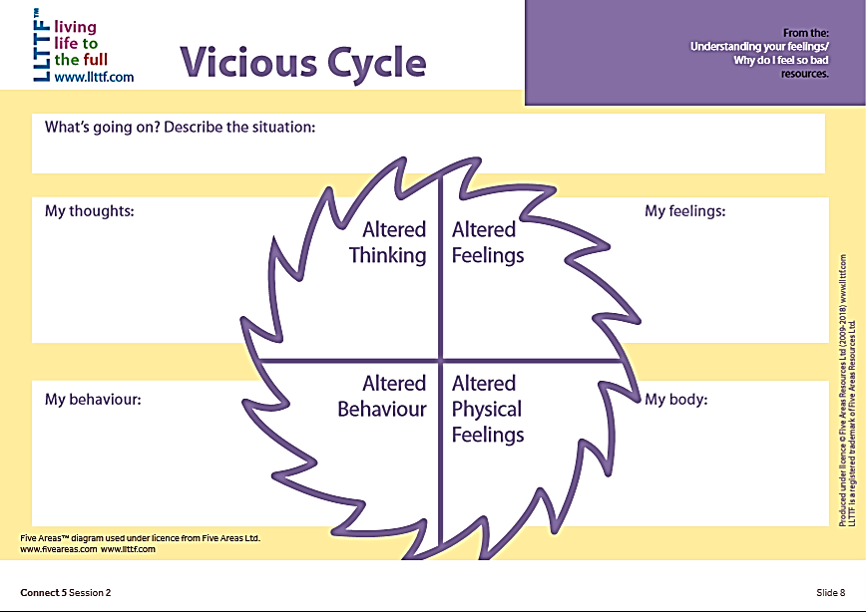
Five Areas Model and the ‘vicious cycle’
Mental Wellbeing in Everyday Practice
Brain injury, trauma
Poor mental health, isolation, self neglect.
a
Thoughts
u
t
t
i
i
o
S
n
Why me? What have I done to deserve this?
Anger, frustration.
I know I am taking it out on others…
Guilt, shame
Loneliness, isolation
I’ve lost everything, I have no one to talk to.
Physical
Behaviour
Snapping, irritable, shouting at others.
Feelings
Adrenaline, increase of blood pressure.
Stopping talking, withdrawing
Tearfulness, lethargy
Self neglect
Numbness, exhaustion
Five Areas™ diagram used under licence from Five Areas Ltd www.fiveareas.com www.llttf.com

Slide 4
Self-Compassion

